Slide 1

The Business of Medicine
Key Performance Indicators – Revenue Cycle
Harris County Medical Society
April A. Bellard, MHA
Director of Payment Advocacy and Practice Management

Slide 2
Disclosure
Please note the content provided herein is informational only, and should NOT, in any way, be considered legal, professional, business, practice, or other advice. Consult your own practice adviser or attorney before taking any action or inaction based on this information.

Slide 3

Best Practices
Best practices promote efficiencies
without sacrificing quality or outcomes.
It is a technique or methodology that,
through experience and research, has
proven to reliably lead to a desired result.
The three main barriers to adoption of a best practice are:
  a lack of knowledge about current best practices
  a lack of motivation to make changes involved in their adoption
  a lack of knowledge and skills required to do so

Slide 4
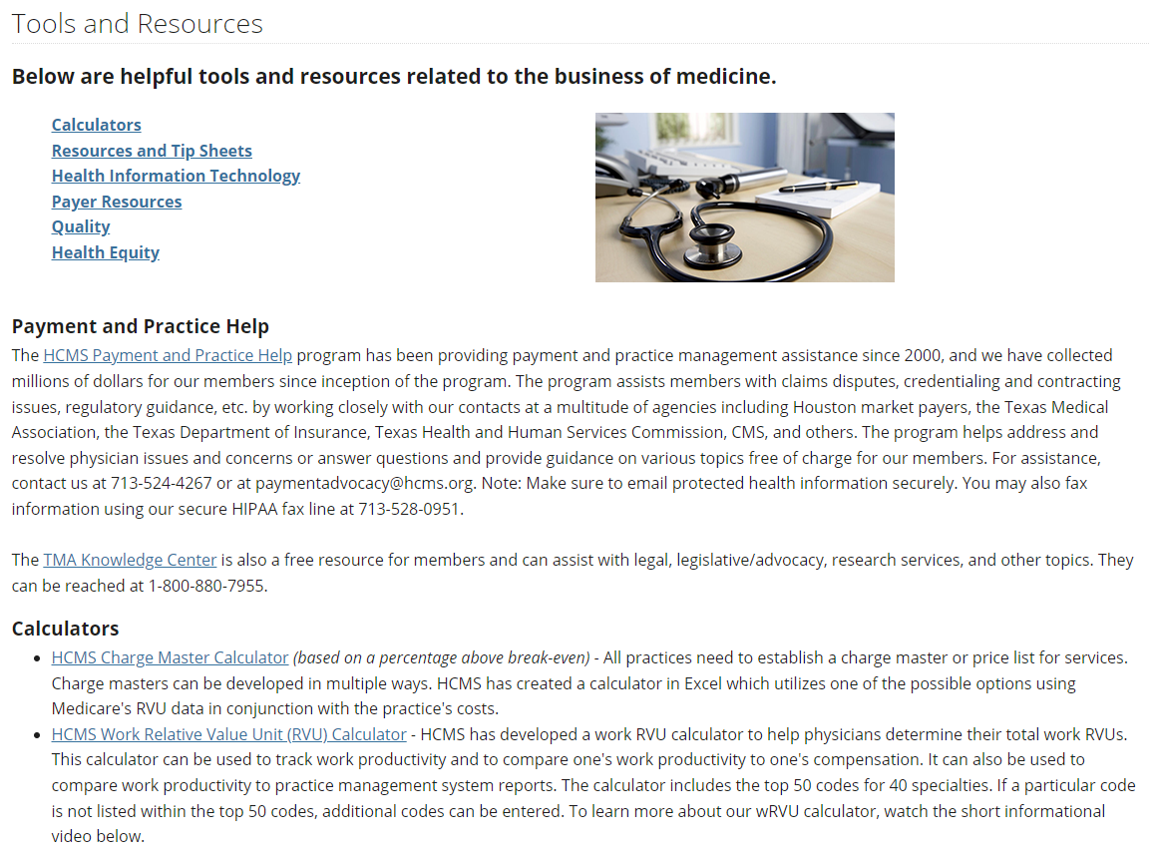
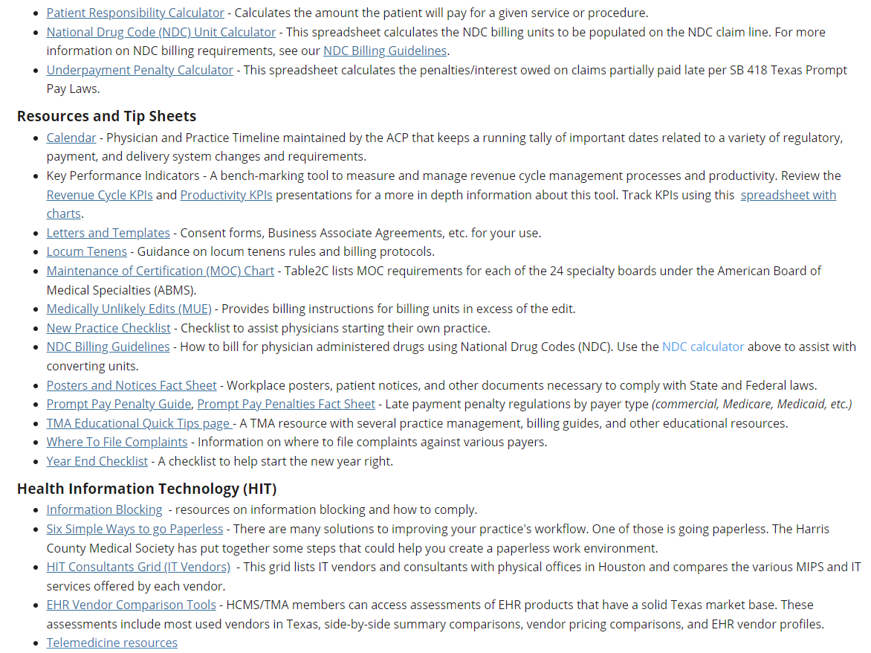
Tools and Resources

Slide 5

RCM Key Performance Indicators
Revenue cycle management (RCM) key performance
indicators (KPI) measure the viability and productivity of
the RCM process. They present a visual and
easy-to-digest means of analyzing operations. Tracking
your organization’s performance can help you improve
services and revenue and give you a greater understanding
of your operations. Additionally, they help bring transparency and accountability and are a useful data visualization tool that helps you build a better understanding of your operations on a more granular level.
The data needed to analyze KPIs should be readily available in your practice management system’s report function. Familiarize yourself with your system’s reporting functions as it already may provide many of these KPIs for you. Run KPIs on a schedule and keep a running chart to identify trends over time.

Slide 6
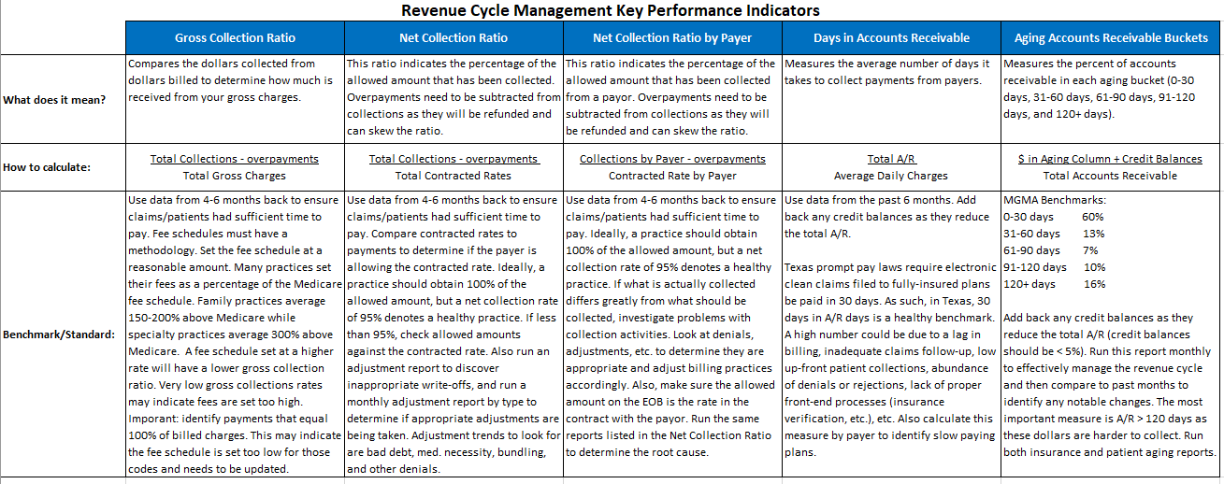
Tools and Resources - Key Performance Indicators https://bit.ly/2rHkPrE

Slide 7
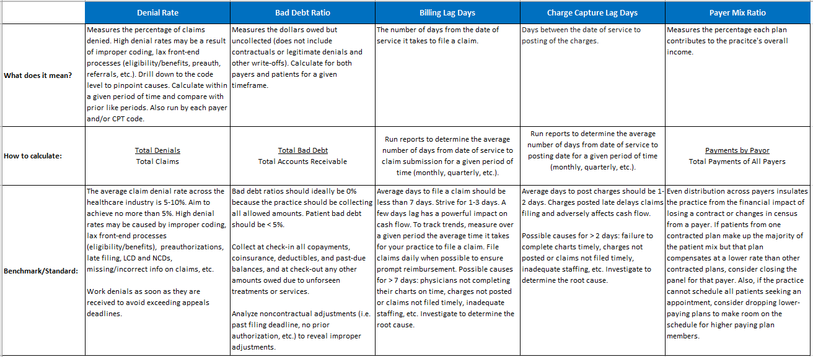
Tools and Resources - Key Performance Indicators https://bit.ly/2rHkPrE

Slide 8
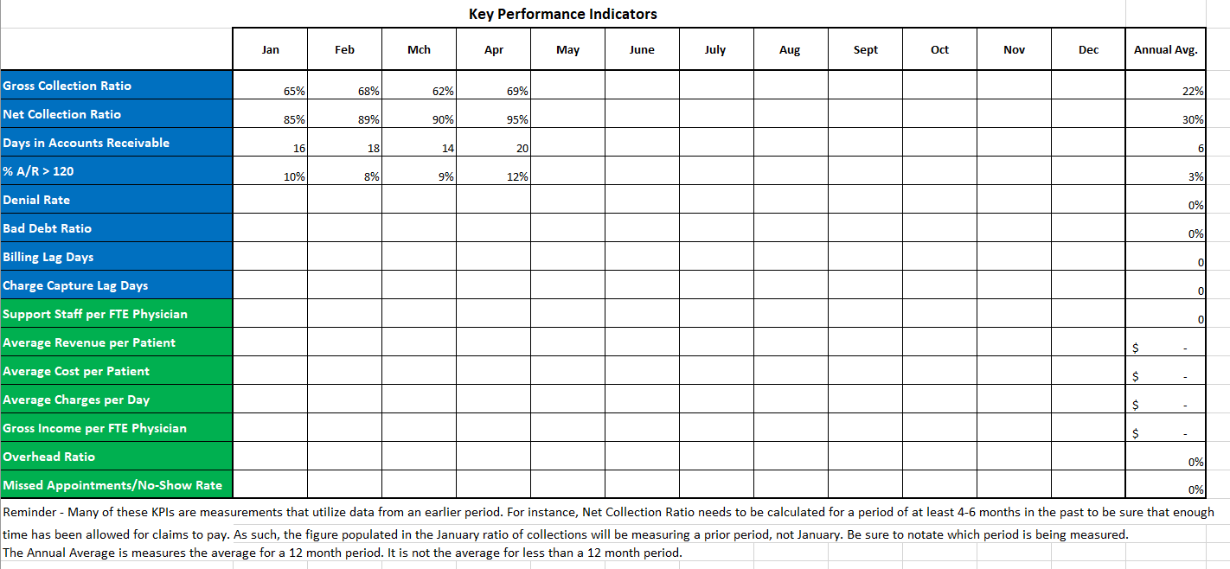
Tools and Resources - Key Performance Indicators

Slide 9
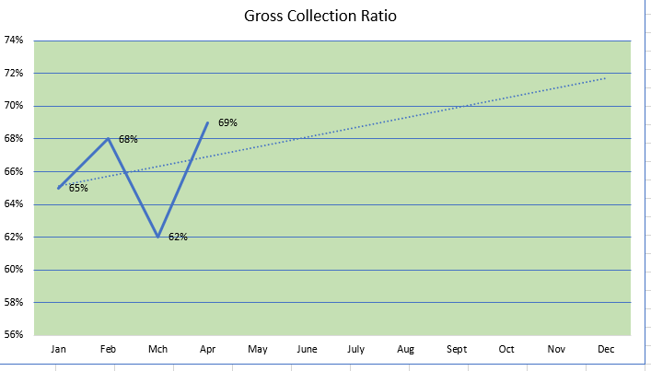
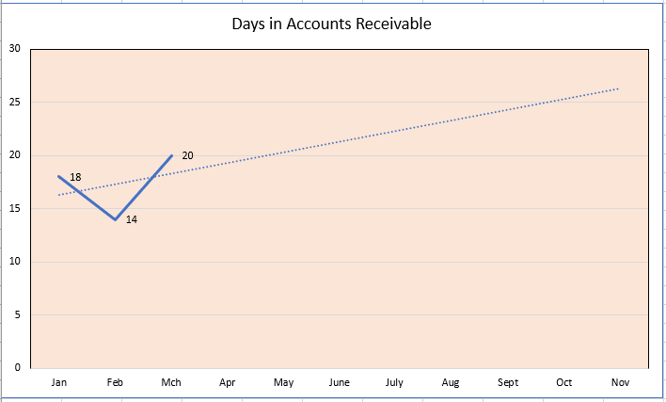
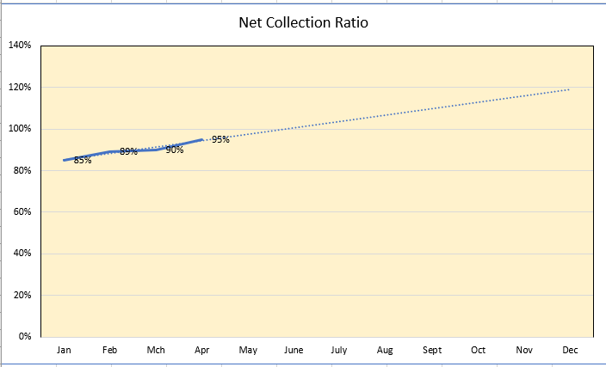
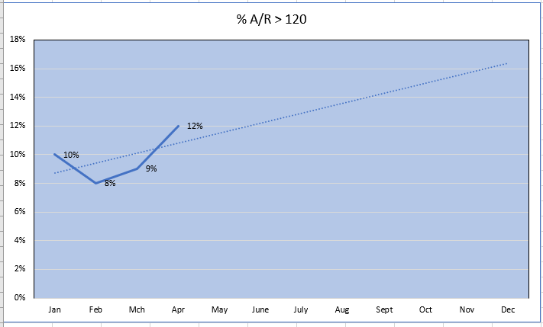
Tools and Resources - Key Performance Indicators https://bit.ly/2rHkPrE

Slide 10
Gross Collections Ratio
Compares the dollars collected from dollars billed to determine how much is received from your gross charges.
  Use data from 4-6 months back to ensure claims had sufficient time to pay.
  High ratios indicate your fee schedule may be too low
  Low ratios may indicate your fee schedule may be too high, poor collections, unfavorable contracted rates, unbalanced payor mix, coding inaccuracy
  Important: Identify payments that equal 100% of billed charges. This may indicate the fee schedule is set too low for those codes and needs to be updated.
Fee schedules must have a methodology. Set your fee schedule at a reasonable rate; Generally family practices average 150-200% above Medicare while specialty practices average 300% above Medicare. You want to set a rate that doesn’t overstate your costs but is high enough that you don’t leave money on the table by billing less than your contracted rate.
Gross charges: $600,000
Overpayments: $5,000 ($65,000-$5,000)/$600,000 = 10%
Collections: $65,000
Total Collections - Overpayments Total Gross Charges | = | Gross Collections Ratio

Slide 11
Net Collections Ratio
This ratio indicates the percentage of the contracted rate (allowed amount) that has been collected. Ideally, you want this ratio to be at 100%, but a net collection rate of 95% or above is an industry average. Use data from 4-6 months back to ensure claims had sufficient time to pay and appeals finalized. Low ratios may indicate:
    Excessive denials – lack of preauth/referral, no insurance verification, incorrect coding, etc.
    Inappropriate adjustments
    Denials are not appealed or appeals are unsuccessful
    Poor collection efforts
    Inappropriate adjustments – Make sure adjustment reasons are accurate. Failing to distinguish between noncontractual adjustments and contractual adjustments results in a misleading view of how well your practice collects the amounts owed by payers. Categorizing noncontractual adjustments (e.g. past filing deadline, preauthorization not obtained, medical necessity, bad debt, etc.) will help reveal sources of errors that need to be addressed.
If the ratio is low, run the calculation by payer to determine if the problem stems from a particular payer. Also run by CPT code to determine if the problem is limited to certain procedures.
Contracted rates: $75,000
Collections: $65,000 ($65,000-$5,000)/$75,000 = 92.3%
Overpayments: $5,000
Total Collections - Overpayments Total Contracted Rates | = | Net Collections Ratio

Slide 12
Days in Accounts Receivable
Measures the average number of days it takes to collect payment. Use data from the past 6 months. The lower the number, the faster a practice is obtaining payment on average. Days in A/R should be below 30 days due to Texas Prompt Pay laws. High A/R days may indicate:
Inadequate follow-up on claims
Lack of up-front collections and poor collection efforts
Problems with benefits/eligibility verification, preauthorizations, improper coding (CPT, modifiers, ICD-10)
Poor use of front-end claim edits
$70,000/$1643.84 = 42.58 days
Gross Charges: $600,000
Total A/R: $70,000 Avg. Daily Collections: $600,000/365 = $1643.84
Total A/R Average Daily Charges | = | Days in A/R

Slide 13
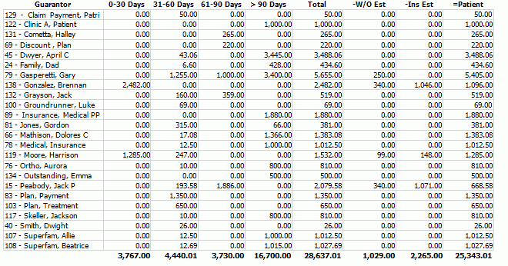
Accounts Receivables Aging
Measures the amount and percent of monies owed in each aging bucket (0-30 days, 31-60 days, 61-90 days, 91-120 days, and 120+ days). Both insurance and patient agings should be analyzed.

Slide 14
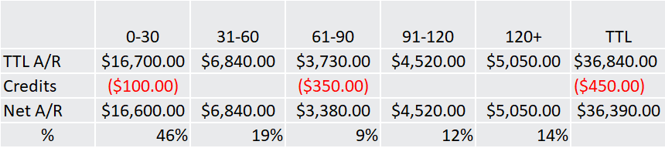
Accounts Receivables Aging
Add back any credit balances as they reduce the total A/R. Run this report monthly to effectively manage the revenue cycle and then compare to past months to identify any notable changes. The most important measure is A/R > 120 days as these dollars are harder to collect.
0-30: (16,7000 – 100)/36,390 = 46%
0-30 A/R + (Credit Balances) | = | 0-30 % of TTL A/R
TTL A/R + (Credit Balances)

Slide 15
Denial Rate
Measures the percentage of claims denied. Strive for 5% or less. High denial rates may be a result of:
Improper coding
Lax front-end processes (eligibility/benefits, preauth, referrals, etc.)
Late filing
Failing to met conditions of coverage
Calculate within a given period of time far back enough to ensure claims have been processed by payers, and compare with prior like periods to identify trends. Drill down to the payer and code level to isolate the problem as it may be a particular payer or procedure that is the culprit. Work denials as soon as they are received to avoid exceeding appeals deadlines. Make sure you fully understand the denial reason. Follow the payer’s appeal process precisely (click on the links to payers on our Billing and Payers page for this information) and specifically address the denial reason in the appeal with supporting documentation highlighted and referenced in the appeal letter.
Total claims: 100
Total denials: 10 10/100 = 10% Denial Rate
Total Denials Total Claims | = | Denial Rate

Slide 16
Bad Debt Ratio
Measures the dollars owed but uncollected (does not include contractuals or legitimate denials and other write-offs). Calculate for both payers and patients for a given timeframe. Bad debt ratios for insurance should ideally be 0% because the practice should be collecting all allowed amounts.
Patient bad debt should be < 5%. Collect at check‐in all patient responsibilities past and present, and at check-out any other amounts owed due to unforseen treatments or services.
Analyze adjustments to reveal improper write-offs or to identify avoidable adjustments.
Total A/R Owed: 100 10/100 = 10% Bad Debt Rate
Total Bad Debt: 10
Total Bad Debt Total A/R (after adjustments) | = | Bad Debt Rate

Slide 17
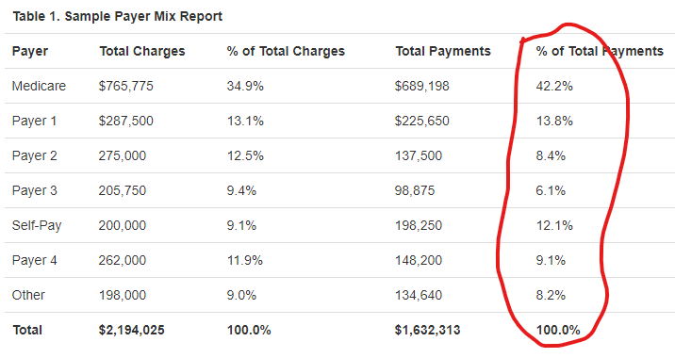
Payer Mix Ratio
Measures the percentage each plan contributes to the practice's overall income. Even distribution across payers insulates the practice from the financial impact of losing a contract or changes in census from a payer. If patients from one contracted plan make up the majority of the patient mix but that plan compensates at a lower rate than other contracted plans, consider closing the panel for that payer. Also, if the practice cannot schedule all patients seeking an appointment, consider dropping lower-paying plans to make room on the schedule for higher paying plan patients.
Payments by Payor Total Payments of All Payers | = | Payer Mix Ratio

Slide 18
Billing Lag and Charge Capture Days
Billing Lag Days - The number of days from the date of service it takes to file a claim. Run reports to determine the average number of days from the date of service to claim submission for a given period of time (monthly, quarterly, etc.). Average days to file a claim should be < 7 days. A few days lag has a powerful impact on cash flow. File claims daily when possible to ensure prompt reimbursement.
Charge Capture Days - The number of days between the date of service to posting of the charges. Run reports to determine the average number of days from date of service to posting date for a given period of time (monthly, quarterly, etc.). Average days to post charges should be 1-2 days. Charges posted late delays claims filing and adversely affects cash flow.
Possible causes:
  Physicians not completing charts on time
  Charges not posted timely
  Claims not filed timely
  Inadequate staffing

Slide 19

HCMS Payment Advocacy Program
HCMS has been providing payment assistance and working to resolve payer-related issues for many years. Since the inception of the Payment Advocacy Program in 2000, HCMS has collected more than $31,000,000 in improperly paid claims, free of charge, for our physician members.

Slide 20

TMA Free Educational Resources
As part of your TMA membership, hundreds of CME, ethics hours, and other educational resources are now available at no cost, compliments of TMA Insurance Trust.

Slide 21
Contacts
Rachel Zetino, MBA, MSHA, VP-Business of Medicine and Operations
rachel_zetino@hcms.org
April Bellard, MHA, Director Payment Advocacy & Practice Management
april_bellard@hcms.org

