Slide 1
Best Practices for Managing Denials
Harris County Medical Society
April A. Bellard, MHA
Director of Payment Advocacy and Practice Management

Slide 2
Disclosure
This presentation is in no way intended to provide advice on business decisions or legal matters.

Slide 3
Revenue Cycle Management (RCM) – Rejected/Denied Claims
Rejected and denied claims adversely affect cash flow and reworking and appealing them is costly. According to the MGMA and Change Healthcare studies:
11% of claims denied on initial submission
50-65% of denied claims are never appealed per a Government Accountability Office study
$6.50 - cost to file a claim
$25 - cost to rework a claim
$118 - cost to appeal a claim
In medical practices, denial rates range from 5-10%, with better performers averaging 4%. Reducing denials even by a fraction of a percent can have a substantial impact on your organization’s bottom line. A good approach is to understand the different types of medical billing denials, pinpoint the most common billing problems, and take steps to avoid them.

Slide 4
Top Denials Root Causes
The Change Healthcare 2022 Revenue Cycle Denials Index

Slide 5
RCM – Denial Rate
What is your denial rate?
Identifying the number of denials is the first step to addressing and avoiding denials. Calculate your denial rate to determine the percent of denials to claims processed for payment:
While the ideal denial rate is 0%, a more realistic rate is 4% or less. Nonetheless, you want to identify what is causing the denials and eliminate all that you can.
Total denials | = | Denial Rate
Total claims

Slide 6
RCM– Identify Root Causes
Determine which codes are being denied by running a report by CPT code. Are several payers denying a particular code or is it isolated to one payer? Drill down further and run this report by payer to determine which payers are responsible for the denials by CPT code. Look for any trends by payer and/or CPT code.
Does a payer have place of service restrictions that other payers do not?
Does a payer deny consult codes as not covered?
Does a payer restrict the use of modifier 25 or 59?
Research the payer’s policies to see if there is a coverage restriction on particular codes or services.

Slide 7
RCM– Implement processes
Put processes in place to address the root causes of the denials and differences in payer policies. Utilize your billing system’s claim edit capabilities. If these are limited, consider purchasing an add-on application that allows you to place more sophisticated alerts/edits. These edits warn you when a claim will likely deny so that you can correct the claim before it is submitted.
Edits can be created to:
warn when a consultation code is billed for a payor who does not cover such.
stop a claim when an add-on code is billed without the primary code.
warn when a claim is in conflict with NCCI rules such as MUE or PTP restrictions.

Slide 8
RCM – Front-End Claim Edits
Claim edits automatically test claims data against an expansive knowledge base containing more than 119 million government and industry rules, regulations, and policies governing health care claims. Utilizing claim edits can reduce rejected and denied claims.
Practice billing systems utilize claim edits to reject claims that lack pertinent information. These rejected claims are never sent to the clearinghouse. If possible, customize these edits to catch coding errors (mod. 25, bilateral, incident-to), payer payment policy variances, NCCI edits (PTP, MUE, add-on codes), etc.
Clearinghouses utilize claim edits to reject claims that lack pertinent information. These rejected claims are never sent to the payer and are identified on the clearinghouse’s acceptance/rejection reports. Some clearinghouses have the ability to customize claim edits for your practice.
Payers utilize claim edits to reject or deny claims. Rejected claims are not accepted by the payer for processing and will not be adjudicated. They can be identified on the payer’s acceptance/rejection reports that will be sent to you from the payer via the clearinghouse. The clock is still ticking on timely filing when a claim is rejected so they must be corrected and resent quickly.

Slide 9
RCM – Front-End Claim Edits
Claim edits to consider:
Bundled CPT codes that require a modifier
Modifier appended to wrong CPT code
Limits on code frequency/units (MUEs)
Mutually exclusive CPT codes
Add-on codes billed without the primary code
Modifier 25 appended to non-E/M code
Modifier 59 appended to E/M code, or to column 1 code
Invalid place of service and CPT code combination
Invalid age or gender and CPT code combination

Slide 10
RCM - Bilateral Billing Guide

Slide 11
RCM - APP Billing Guide

Slide 12
RCM– Payer Policies
Be cognizant of differences in payers’ billing rules like place of service restrictions, multiple procedure payment reduction policies, and conditions of coverage. Utilize the payer’s cost/claims estimator if there is uncertainty on how a claim will process. You will be provided a real-time estimate of patient costs, potential denials, and payment reductions before you provide a service or submit a claim.
Aetna
BCBSTX
Cigna
Humana
UHC

Slide 13
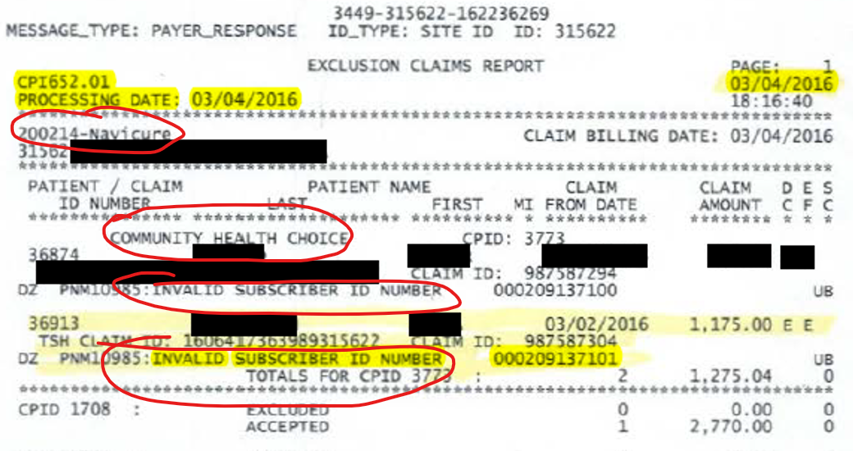
RCM - Claims Reports
Rejection report from payor

Slide 14
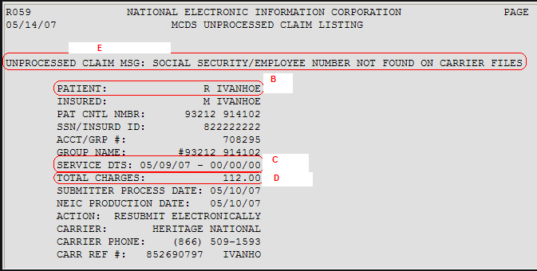
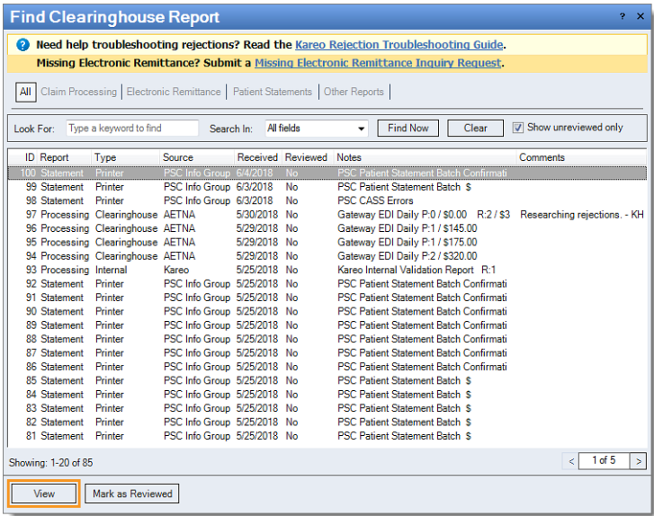
RCM - Claims Reports
EHR downloads or reports
Rejection report from payor
EHR import of payor responses for claim

Slide 15
RCM - Appeals
EOBs and remittances too often provide confusing, misleading, or inaccurate reasons for denial. Payors may use standard remark codes published by X12 or may use their own proprietary codes. For an appeal to be successful, you must first understand the cause of the denial. If the denial reason does not make sense or provide enough information, call the payor to obtain a clear explanation. Don’t settle for a re-reading of the EOB’s denial messaging by a claims representative. Insist that a valid and sensible reason be provided, and if it is not, ask for a supervisor.
Remittance Advice Remark Codes (RARC) and Claim Adjustment Reason Codes (CARC) on the EOB/RA often provide confusing, misleading, or inaccurate reasons for denial. Payors may use proprietary remark codes rather than those published by X12.
CARCs describe why a claim or service line was paid differently than it was billed.
RARCs provide additional information about a CARC code. Some are Alerts used to convey information about remittance processing and are never related to a CARC.

Slide 16
Claim Adjustment Reason Codes (CARC)
Claim Adjustment Reason Codes (CARC)
Code | Message | Possible Cause
4 | The procedure code is inconsistent with the modifier used or a required modifier is missing. | Modifier appended to wrong CPT code; wrong anatomical modifier; mod. not allowed
16 | Claim/service lacks information or has submission/billing error(s). | NDC; modifier; etc. - look for RARC
50 | These are non-covered services because this is not deemed a 'medical necessity' by the payer. | Cosmetic; pre-existing; conditions of coverage not met; LCD, NCD, payor policy
55 | Procedure/treatment/drug is deemed experimental/investigational by the payer. | Conditions of coverage not met; not covered; modifier needed; NDC; documentation
58 | Treatment was deemed by the payer to have been rendered in an inappropriate or invalid place of service. | Facility or Non-Facility NA Indicator; hosp. OBS;
96 | Non-covered charge(s). At least one Remark Code must be provided | Not fee sched.; cosmetic; pre-existing;
97 | The benefit for this service is included in the payment/allowance for another service/procedure that has already been adjudicated. | Bundling - check the CMS PTP files to confirm or CGS Medicare PTP look-up tool; Modifier needed
234 | This procedure is not paid separately. At least one Remark Code must be provided.
107 | The related or qualifying claim/service was not identified on this claim. | Add-on code billed w/o primary code; Claim for a qualifying service has not been adjudicated (CT scan as condition of coverage)
B15 | This service/procedure requires that a qualifying service/procedure be received and covered. The qualifying other service/procedure has not been received/adjudicated. | Facility claim not processed; Asst. surgeon; Mastectomy/reconstruction
151 | Payment adjusted because the payer deems the information submitted does not support this many/frequency of services. | MUE; Service provided too soon (physical, AWV, etc.)
252 | An attachment/other documentation is required to adjudicate this claim/service. | Request for medical records, invoice
B7 | This provider was not certified/eligible to be paid for this procedure/service on this date of service. | May be radiology services without required certification.
185 | The rendering provider is not eligible to perform the service billed.
B12 | Services not documented in patient's medical records. | Documentation does not support code; procedure partially performed; E/M level - required elements not documented
150 | Payer deems the information submitted does not support this level of service.

Slide 17
Remittance Advice Remark Codes (RARC)
Remark Adjustment Reason Codes (RARC)
Code | Message | Possible Cause
M15 | Separately billed services/tests have been bundled as they are considered components of the same procedure. Separate payment is not allowed. | Modifier needed; bundling - check the CMS NCCI PTP files to confirm or use CGS PTP look-up tool
N19 | Procedure code incidental to primary procedure.
M51 | Missing/incomplete/invalid procedure code(s). | Conditions of coverage not met; not covered; modifier needed; NDC; documentation
MA66 | Missing/incomplete/invalid principal procedure code. | Add-on code not billed w/ its primary code
M53 | Missing/incomplete/invalid days or units of service. | MUE; NDC vs HCPCS; NDC units;
M76 | Missing/incomplete/invalid diagnosis or condition. | Primary/secondary placement; excludes 1/2 notes
MA63 | Missing/incomplete/invalid principal diagnosis. | Primary/secondary placement
M119 | Missing/incomplete/invalid/ deactivated/withdrawn National Drug Code (NDC). | Incorrect or missing NDC format or number
N815 | Missing/Incomplete/Invalid NDC Unit Count | NDC units are different than HCPCS unit and must be converted to ML and calculated
N816 | Missing/Incomplete/Invalid NDC Unit of Measure | Measure not converted to ML or misreported
N823 | Incomplete/Invalid procedure modifier(s). | Misuse of mod.; appended to wrong CPT; mod needed
N115 | This decision was based on a Local Coverage Determination (LCD). A copy of this policy is available at www.cms.gov/mcd, or if you do not have web access, you may contact the contractor to request a copy of the LCD. | Conditions of coverage not met; not covered; modifier needed; documentation incomplete
N386 | This decision was based on a National Coverage Determination (NCD). A copy of this policy is available at www.cms.gov/mcd/search.asp. If you do not have web access, you may contact the contractor to request a copy of the NCD.
N428 | Not covered when performed in this place of service. | Facility or Non-Facility NA Indicator; hosp. OBS;
N640 | Exceeds number/frequency approved/allowed within time period. | Well visits; AWV, IPPE; another physician billed;
N472 | Payment for this service has been issued to another provider. | Hosp IP/OBS modifier AI
N705 | Incomplete/invalid documentation. | Missing signature, DOS, etc.; doc. doesn't support; doc. not submitted
N237 | Incomplete/invalid patient medical record for this service.
N706 | Missing documentation.
N808 | Not covered for this provider type / provider specialty. | Usually service requires certification (radiology services)
MA130 | Your claim contains incomplete and/or invalid information, and no appeal rights are afforded because the claim is unprocessable. Please submit a new claim. | Usually claim field not correctly populated

Slide 18
RCM - Appeals
Elements of an effective appeal:
Be clear and concise:
Do not make general statements such as the service was medically necessary or make accusations that the payer is not playing fair.
Address only the denial reason. Do not elaborate on the procedure or patient’s condition unless it speaks to the denial specifically.
Do not provide extraneous information as this only detracts the reviewer from the important information.
Do not provide records that are not needed to refute the denial. Reviewers will not wade through a large file of information irrelevant to the denial.
Reviewers will not make assumptions so it is imperative that the documentation is very clear and leaves no room for interpretation

Slide 19
RCM - Appeals
Elements of an effective appeal (cont.):
Provide proof:
Provide only evidence needed to refute the denial.
Highlight in the medical record or other documentation where the evidence is located. Label attachments if there are several. For example:
Documentation doesn’t support the service billed - Simply sending a copy of the medical record will not suffice. If the denial states the documentation doesn’t support the claim, highlight exactly where in the medical record the information to support the claim is located and cite its location in the appeal letter.
Coverage/Reimbursement policy denials- If the denial is in regard to a coverage policy, attach the payor’s policy to the appeal and highlight in the medical record where the conditions of coverage are located.

Slide 20
RCM - Appeals
Elements of an effective appeal (cont.):
Workflow:
Templates – Develop templates to use for the most common denials to streamline the appeals process.
Follow the payer’s appeals process exactly and utilize online portals to file appeals to avoid loss or separation of documents (see “Payors” on the Billing and Payors page).
Closely monitor the appeal determination deadline and check status if exceeded.
Review the appeal determination letter and if an adverse determination is given, follow the instructions in the letter to file a second level appeal.

Slide 21
RCM - Appeals
Elements of an effective appeal (cont.):
Workflow:
Templates – Develop templates to use for the most common denials to streamline the appeals process.
Follow the payer’s appeals process exactly and utilize online portals to file appeals to avoid loss or separation of documents (see “Payors” on the Billing and Payors page).
Closely monitor the appeal determination deadline and check status if exceeded.
Review the appeal determination letter and if an adverse determination is given, follow the instructions in the letter to file a second level appeal.

Slide 22
Where to file complaints
When appeals are denied in error, you may file a complaint with the appropriate regulatory entity.
Fully-insured plans – The Texas Department of Insurance (TDI) handles complaints for fully-insured and CHIP HMO plans. Use the online complaint portal.
Self-Funded Health Plans - Employee Retirement Income Security Act (ERISA) regulates these plans. There is little relief for physicians under ERISA. As the patient’s employer is responsible for claim payment, get the patient involved and/or contact the employer’s Human Resources department.
Medicare/Medicare Advantage – Complaints may be filed with the Dallas CMS Regional Administrator using their complaint form.

Slide 23
Where to file complaints
Medicaid/Medicaid Managed Care Plans – Before filing a complaint with HHS, you must exhaust the plan’s appeals and/or complaint process.
Traditional Medicaid (TMHP) – send complaints to:
Texas Health and Human Services Commission HHSC Claims Administrator Contract Management PO Box 204077, Mail Code 91-X
Austin, Texas 78720-4077
Phone: (512) 249-3744
Managed Care Org. (MCO) – for all but STAR plans, email complaints to HPM_complaints@hhsc.state.tx.us. For STAR plans email STAR.Health@hhsc.state.tx.us. The steps in the MCO complaint process provide additional information

Slide 24
HCMS Payment Advocacy Program
HCMS has been providing payment assistance and working to resolve payer-related issues for many years. Since the inception of the Payment Advocacy Program in 2000, HCMS has collected more than $31,000,000 in improperly paid claims, free of charge, for our physician members.

Slide 25
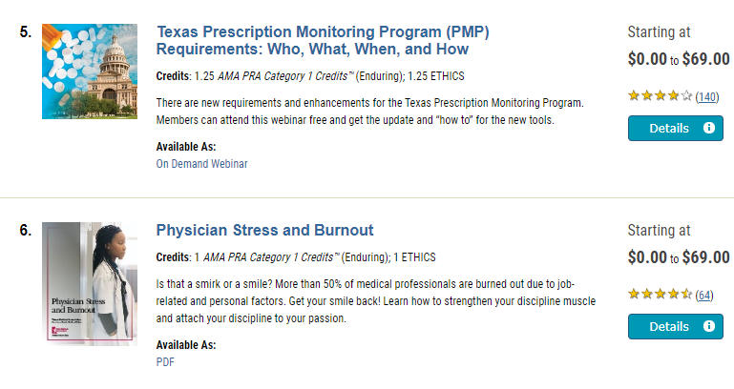
TMA Free Educational Resources
As part of your TMA membership, hundreds of CME, ethics hours, and other educational resources are now available at no cost, compliments of TMA Insurance Trust.

Slide 26
Contacts
Rachel Zetino, MBA, MSHA, VP-Business of Medicine and Operations
rachel_zetino@hcms.org
April Bellard, MHA, Director Payment Advocacy & Practice Management
april_bellard@hcms.org

