Slide 1
The Business of Medicine
Key Performance Indicators – Productivity
Harris County Medical Society
April A. Bellard, MHA
Director of Payment Advocacy and Practice Management

Slide 2
Disclaimer
Please note the content provided herein is informational only, and should NOT, in any way, be considered legal, professional, business, practice, or other advice. Consult your own practice adviser or attorney before taking any action or inaction based on this information.

Slide 3
Best Practices
Best practices promote efficiencies
without sacrificing quality or outcomes.
It is a technique or methodology that,
through experience and research, has
proven to reliably lead to a desired result.
The three main barriers to adoption of a best practice are:
a lack of knowledge about current best practices
a lack of motivation to make changes involved in their adoption
a lack of knowledge and skills required to do so

Slide 4
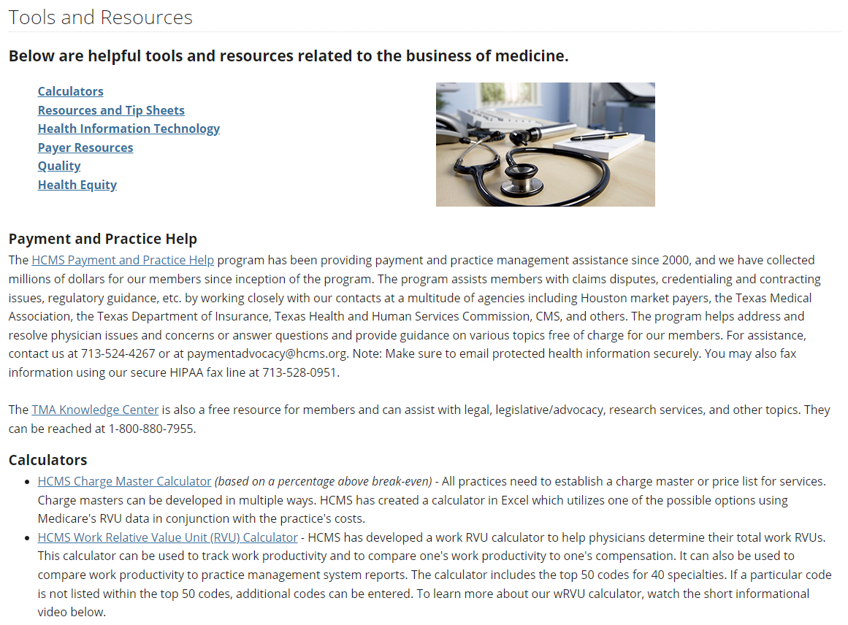
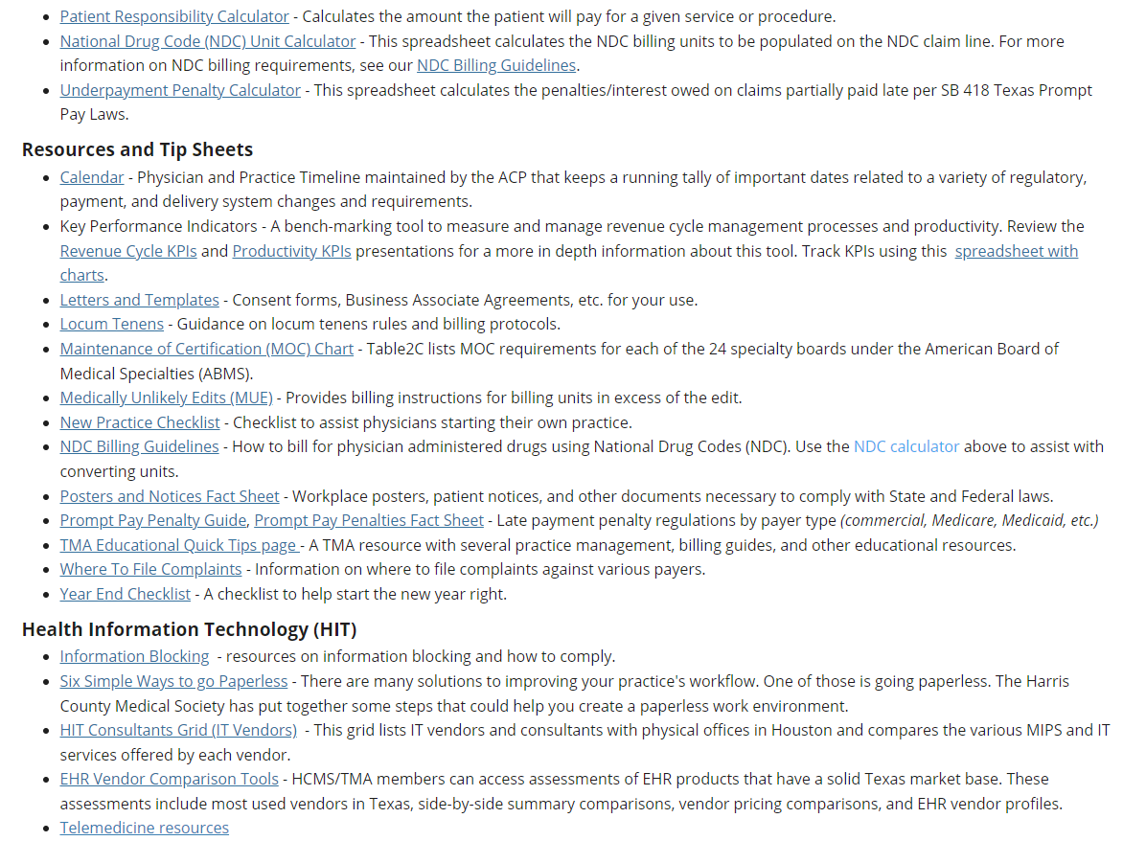
Tools and Resources

Slide 5
Productivity Key Performance Indicators
Productivity KPIs measure the viability and productivity of
the practice. They present a visual and
easy-to-digest means of analyzing operations. Tracking
your organization’s performance can help you improve
services and revenue and give you a greater understanding
of your operations. Additionally, they help bring
transparency and accountability and are a useful data visualization tool that helps you build a better understanding of your operations on a more granular level.
The data needed to analyze KPIs should be readily available in your practice management system’s report function. Familiarize yourself with your system’s reporting functions as it already may provide many of these KPIs for you. Run KPIs on a schedule and keep a running chart to identify trends over time.

Slide 6
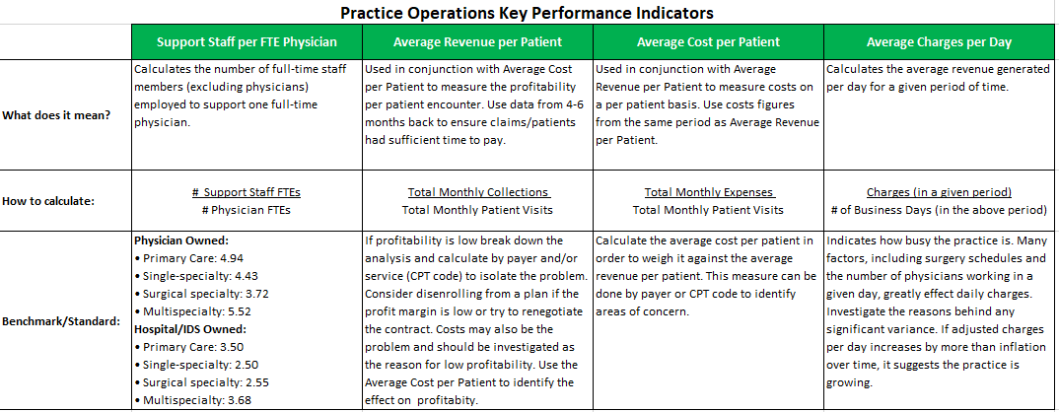
Key Performance Indicators - Productivity

Slide 7
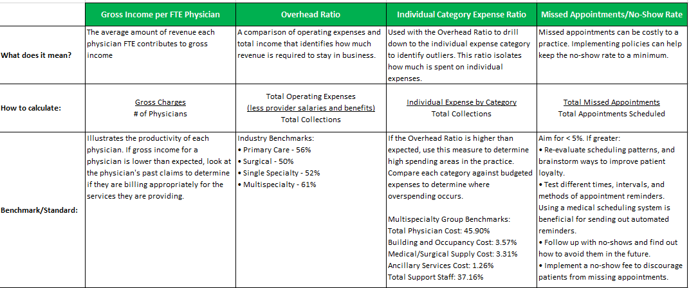
Key Performance Indicators - Productivity

Slide 8
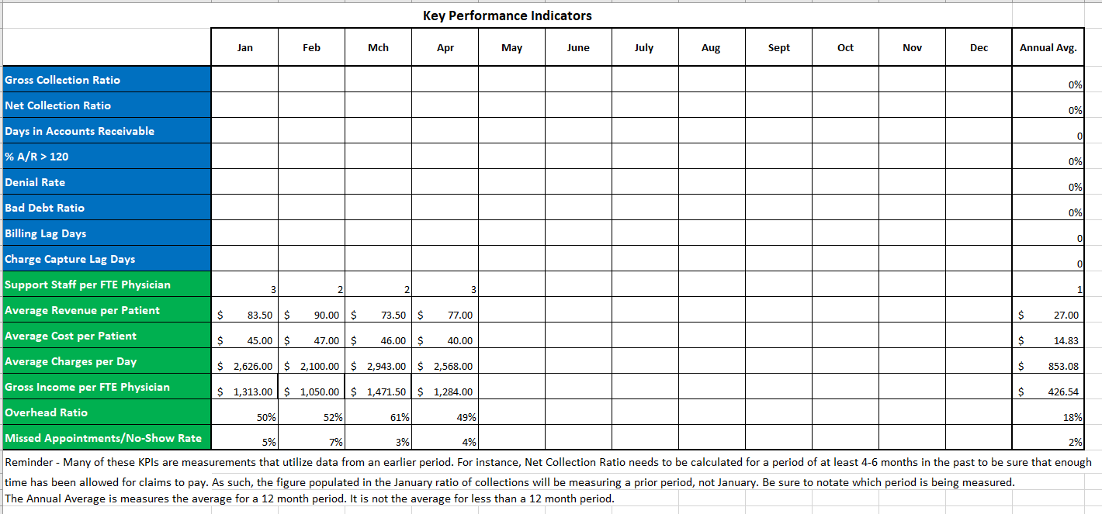
Key Performance Indicators – Productivity Tracking

Slide 9
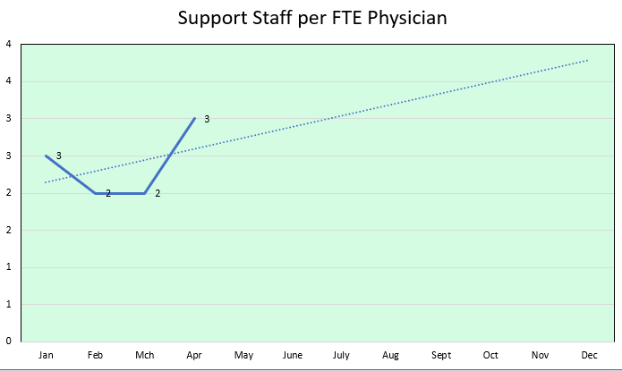
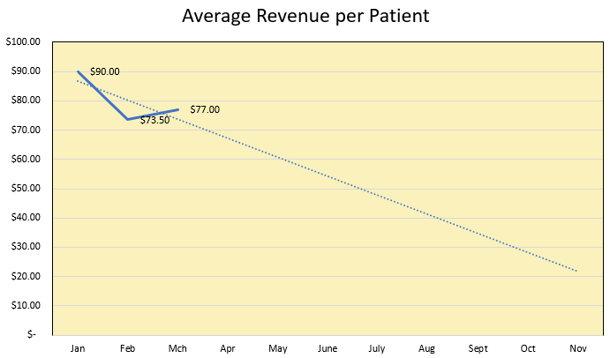
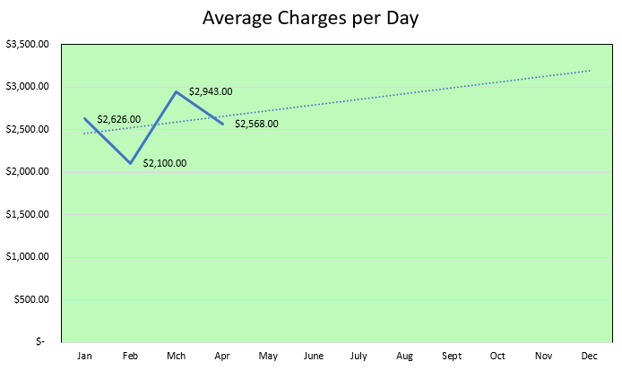
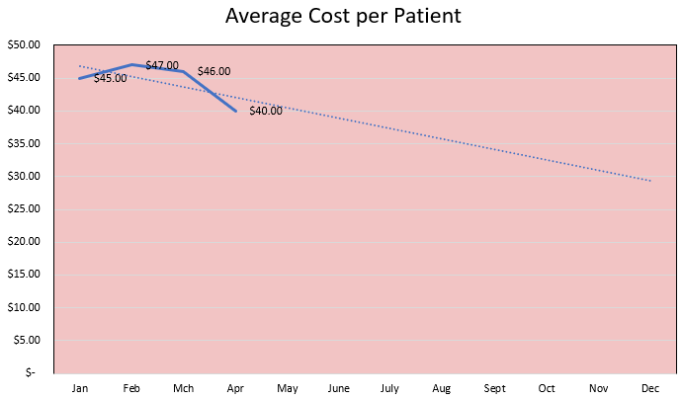
Key Performance Indicators – Productivity Charting

Slide 10
KPI – Support Staff per Physician FTE
Calculates the number of full-time non-physician staff members employed to support one full-time physician.
Benchmarks:
Physician Owned
Primary Care: 4.94
Single-specialty: 4.43
Surgical specialty: 3.72
Multispecialty: 5.52 Staff: 8
Hospital/IDS Owned Physicians: 3
Primary Care: 3.50
Single-specialty: 2.50
Surgical specialty: 2.55
Multispecialty: 3.68
# Support Staff FTEs # Physician FTEs | = | Support Staff Ratio
8 3 | = | 2.67

Slide 11
KPI - Average Revenue per Patient
Used in conjunction with Average Cost per Patient to measure the profitability per patient encounter. Use data from 4-6 months back to ensure claims/patients had sufficient time to pay.
If profitability is low, break down the analysis and calculate by payer and/or service (CPT code) to isolate the problem. Consider disenrolling from a plan if the profit margin is low or try to renegotiate the contract. Costs may also be the problem and should be investigated as the reason for low profitability. Use the Average Cost per Patient to identify the effect of cost on profitability.
Collections: $56,000
Visits: 520
Total Monthly Collections Total Monthly Patient Visits | = | Average Revenue per Patient
$56,000 520 | = | $107.69

Slide 12
KPI - Average Cost per Patient
Used in conjunction with Average Revenue per Patient to measure costs on a per patient basis. Use costs figures from the same period as Average Revenue per Patient.
Calculate the average cost per patient in order to weigh it against the average revenue per patient. This calculation can be performed by payer or CPT code to identify areas of concern.
Expenses: $34,000
Visits: 520
Total Monthly Expenses Total Monthly Patient Visits | = | Average Cost per Patient
$34,000 520 | = | $65.38

Slide 13
KPI - Average Charges per Day
Calculates the average billed charges generated per day for a given period of time.
Many factors, including surgery schedules and the number of physicians working in a given day, greatly effect daily charges. Investigate the reasons behind any significant variance. If average charges per day increases by more than the rate of inflation over time, it suggests the practice is growing.
Monthly Charges: $73,000
Days: 30
Charges (in a given period) # of Business Days (in the above period) | = | Average Charges per Day
$73,000 30 | = | $2,433.33

Slide 14
KPI – Gross Income per Physician FTE
Measures the average amount of revenue each physician FTE contributes to gross income and illustrates the productivity of each physician during a given period of time. If gross income for a physician is lower than expected, look at patient volume to determine any reductions in volume (schedule availability, PTO, visit length). If volume has remained steady, look at changes in services billed. If there are no significant variances, review the physician's past claims to determine if they are billing appropriately for the services they are providing.
Gross Monthly Charges: $73,000
# of Physician FTEs: 2
Gross Monthly Charges # of Physicians | = | Gross Monthly Income per Physician
$73,000 2 | = | $36,500.00

Slide 15
KPI – Overhead Ratio
A measurement of the operating costs (not including physician salaries/benefits) of doing business compared to the company's income. A low overhead ratio indicates that a company is minimizing business expenses that are not directly related to production.
Industry Benchmarks:
Primary Care - 56%
Surgical - 50%
Single Specialty - 52%
Multispecialty - 61%
TTL Operating Expenses: $29,000
Total Collections: $56,000
Total Operating Expenses (less provider salaries and benefits) Total Collections | = | Overhead Ratio
$29,000 $56,000 | = | 51%

Slide 16
KPI – Individual Category Expense Ratio
Used with the Overhead Ratio to drill down to the individual expense category to identify outliers. This ratio isolates how much is spent on individual expenses.
If the Overhead Ratio is higher than expected, use this measure to determine high spending areas in the practice. Compare each category against budgeted expenses to determine where over-spending occurs.
Multispecialty Group Benchmarks:
Total Physician Cost: 45.90%
Building and Occupancy Cost: 3.57%
Medical/Surgical Supply Cost: 3.31%
Ancillary Services Cost: 1.26%
Total Support Staff: 37.16%
Rent: $5500
TTL Monthly Collections: $56,000
Individual Expense by Category Total Collections | = | Individual Expense Ratio
$5500 $56,000 | = | 9.80%

Slide 17
KPI – No-show Ratio
Measures the number of no-shows compared to appointments kept. Missed appointments are costly to a practice. Implementing policies to discourage no-shows can help keep the no-show rate to a minimum.
Aim for < 5%. If greater:
Re-evaluate scheduling patterns and brainstorm ways to improve patient loyalty.
Test different times, intervals, and methods of appointment reminders. Using an automated appointment reminder system can efficient and effective to mitigate high no-show rates.
Follow up with no-shows and find out how to avert them in the future.
Implement a no-show fee to discourage patients from missing appointments.
TTL Monthly No-Shows: 38
TTL Monthly Appointments: 520
Total Missed Appointments Total Appointments Scheduled | = | No-show Ratio
38 520 | = | 7.30%

Slide 18
HCMS Payment Advocacy Program
HCMS has been providing payment assistance and working to resolve payer-related issues for many years. Since the inception of the Payment Advocacy Program in 2000, HCMS has collected more than $31,000,000 in improperly paid claims, free of charge, for our physician members.

Slide 19
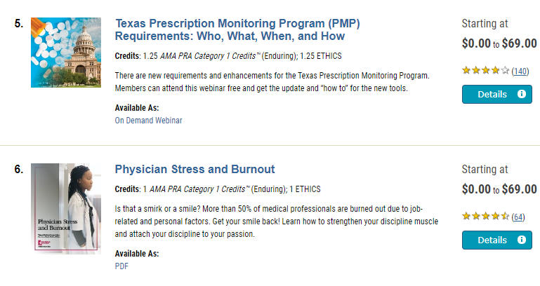
TMA Free Educational Resources
As part of your TMA membership, hundreds of CME, ethics hours, and other educational resources are now available at no cost, compliments of TMA Insurance Trust.

Slide 20
Contacts
Rachel Zetino, MBA, MSHA, VP-Business of Medicine and Operations
rachel_zetino@hcms.org
April Bellard, MHA, Director Payment Advocacy & Practice Management. april_bellard@hcms.org

